Slide 1

1. profile
python

Slide 2
1.1 sources
Feature Description Official Documentation
sys.setprofile The core engine for deterministic profiling.
This function registers a callback that the Python interpreter executes for events like function calls (call, c_call)
and returns (return, c_return), allowing you to hook into the execution flow to record data.[1][2] sys — System-specific parameters and functions
Metaclasses A feature for customizing class creation itself.[3][4] A metaclass can automatically wrap all methods of a class
with profiling logic, enabling seamless, class-level profiling without requiring manual
decorators on each method.[5][6] What are Metaclasses?
Decorators Functions that modify or enhance other functions.[7][8][9]
They provide a clean, "Pythonic" syntax (@my_profiler) for applying profiling logic to specific, targeted functions
or methods.[10][11] Glossary - Decorator
Context Managers Objects that manage a block of code executed within a with statement.[12][13][14]
They are perfect for profiling arbitrary code sections by starting a timer on __enter__ and
stopping it on __exit__, which is guaranteed to run.[15] contextlib — Utilities for with-statement contexts
inspect Module A powerful tool for introspection of live Python objects like modules, classes, and functions.[16][17][18]
It's essential for retrieving metadata from frame objects—such as function names, line numbers, and source
files—to generate useful and readable profiling reports.[19][20] inspect — Inspect live objects

Slide 3

1.1.1 tools
sys
Category Description Packages with Tutorial Links
Essential Core modules that provide fundamental insight into Python's runtime behavior, object system,
and memory management.
These are the building blocks for understanding how Python works internally. sys • inspect • types • dis • gc
Intermediate Advanced introspection and system internals that build on the essential modules.
Critical for understanding Python's compilation process, import system, and debugging capabilities. ast • code • importlib • traceback • threading
Advanced Low-level system interaction and memory analysis tools.
These provide deep insights into Python's C implementation and are essential for performance optimization
and debugging complex issues. ctypes • marshal • frame objects • tracemalloc • faulthandler
Specialized Performance analysis and advanced code inspection tools. Use these when you need detailed performance
metrics, code coverage analysis, or want to understand Python's tokenization and compilation phases. profile/cProfile • trace • tokenize • opcode

Slide 4
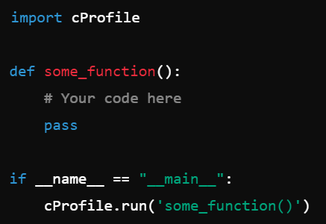
2. cProfile

Slide 5
3. profile

Slide 6





Z. template
new project
ExecuteAsync
square post-it
download
  exe
download
  exe
why
A slash
  followed
by
  two consecutive asterisks
D:\A1_research\C2_c0dice\B1_jmeter\A1_install
functionalities
introduction
build-exe
entity framework plus
zig help
⊂
4
every key-frame
defines the operation
success

